Slide 1
Smart Home Exhaust System

Slide 2



Team members
Shakil Anowar Samrat
Nuruzzaman Ashrafi
Izaz Uddin Mahmud

Slide 3
Contents
1
Introduction
2
Hardware used
3
Implementation
4
Program
5
Result
6
Application and Future Scope
7
Limitations

Slide 4
This project presents an innovative technology called the "Smart Home Exhaust System" that has been developed to improve energy efficiency, indoor air quality, and user experience in modern homes.
INTRODUCTION

Slide 5
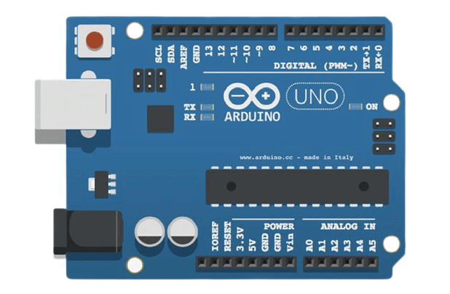
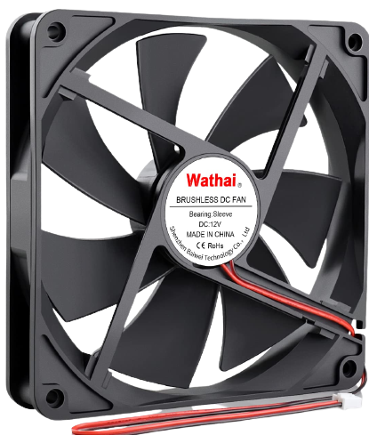
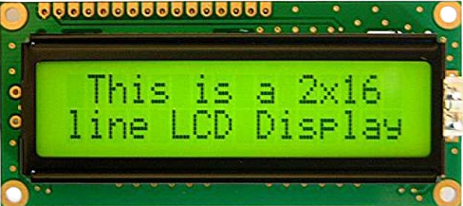
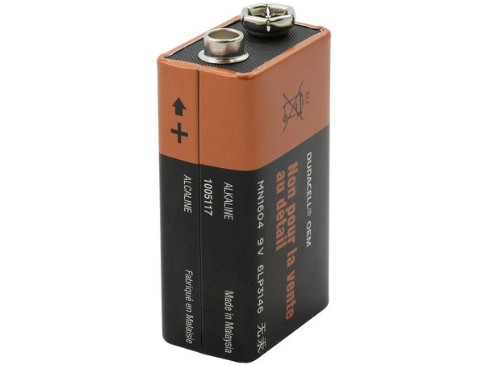
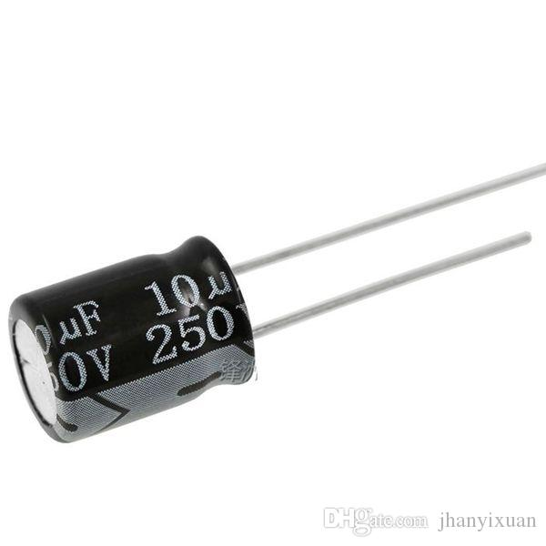
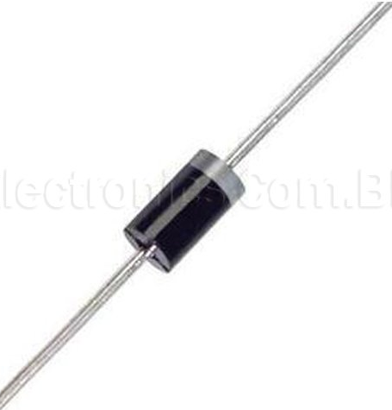
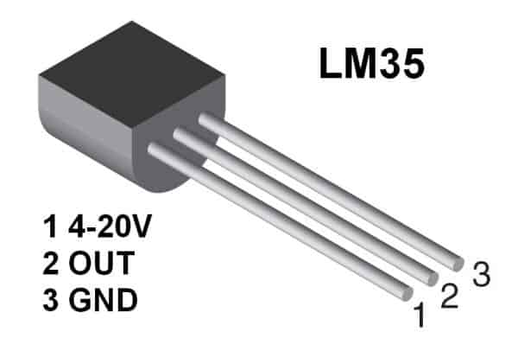
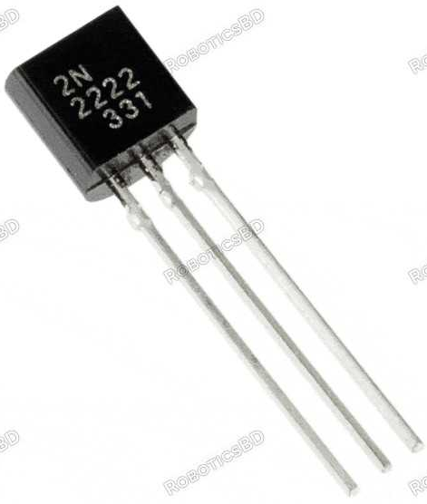
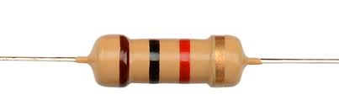
Instruments /Hardware
Arduino
16*2 Display
DC Fan
9V Battery
Capacitor
Diode
Sensor
Transistor
Resistor

Slide 6
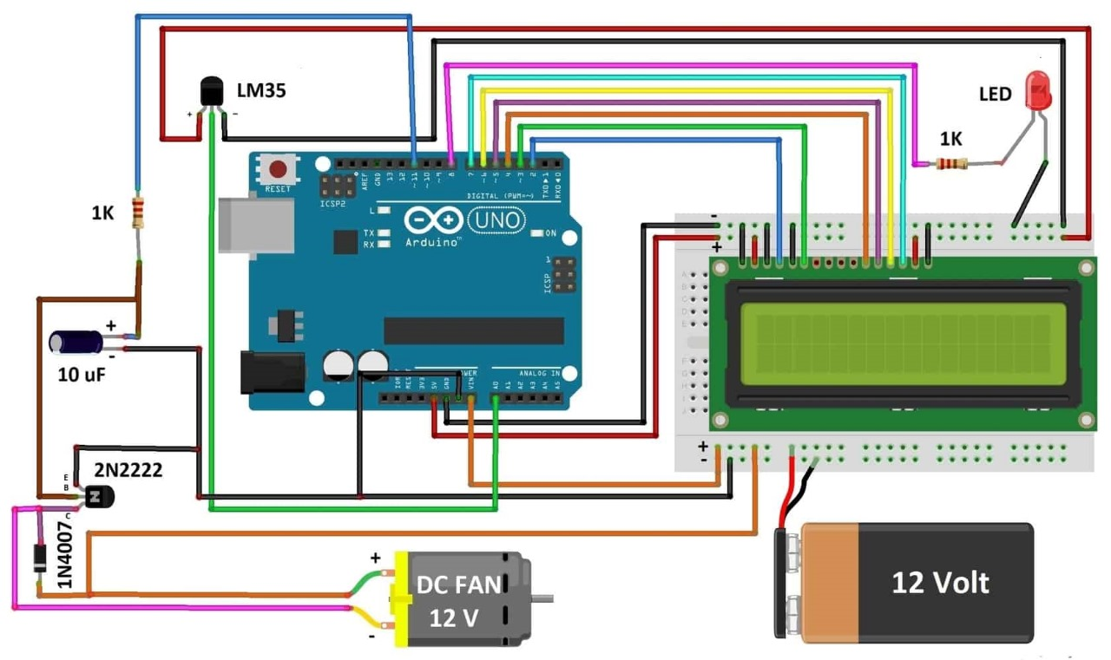
Circuit Diagram

Slide 7
Program
The program for Smart Home Exhaust System With Arduino is given below
#include <LiquidCrystal.h>
LiquidCrystal lcd(2,3,4,5,6,7);
int tempPin = A0; // the output pin of LM35
int fan = 11; // the pin where fan is
int led = 8; // led pin
int temp;
int tempMin = 30; // the temperature to start the fan 0%
int tempMax = 60;
// the maximum temperature when fan is at 100%
int fanSpeed;
int fanLCD;
void setup() {
pinMode(fan, OUTPUT);
pinMode(led, OUTPUT);
pinMode(tempPin, INPUT);
lcd.begin(16,2);
Serial.begin(9600);
}
void loop()
{
temp = readTemp(); // get the temperature
Serial.print( temp );
if(temp < tempMin) // if temp is lower than minimum temp
{
fanSpeed = 0; // fan is not spinning
analogWrite(fan, fanSpeed);
fanLCD=0;
digitalWrite(fan, LOW);
}
if((temp >= tempMin) && (temp <= tempMax))
{
fanSpeed = temp;
fanSpeed=1.5*fanSpeed;
fanLCD = map(temp, tempMin, tempMax, 0, 100);
// speed of fan to display on LCD100
analogWrite(fan, fanSpeed); // spin the fan at the fanSpeed speed
}
if(temp > tempMax) // if temp is higher than tempMax
{
digitalWrite(led, HIGH); // turn on led
}
else // else turn of led
{digitalWrite(led, LOW);}
lcd.print("TEMP: ");
lcd.print(temp); // display the temperature
lcd.print("C ");
lcd.setCursor(0,1); // move cursor to next line
lcd.print("FANS: ");
lcd.print(fanLCD); // display the fan speed
lcd.print("%");
delay(200);
lcd.clear();
}
int readTemp() { // get the temperature and convert it to celsius
temp = analogRead(tempPin);
return temp * 0.48828125;
}

Slide 8
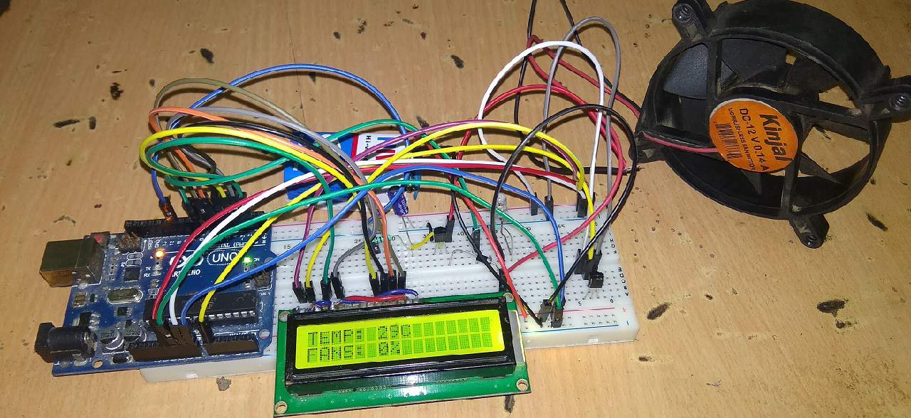
Result

Slide 9
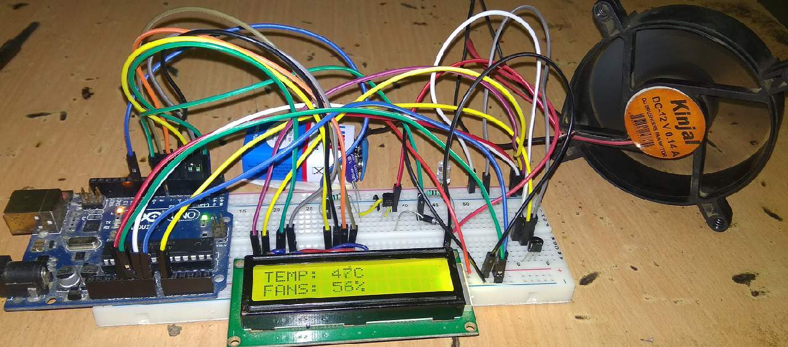
Result (continue)

Slide 10
Applications
1
Room exhaust system
Air conditioner
2
Heat exchanger
3
4
Furnaces
Incubator
5
Veterinary operating tables
6
Heat exchanger
7

Slide 11
Limitations
The system requires DC current to operate. It is not for controlling the AC fans which leads to our main limitation
The System runs on DC battery power. Running it continuously to control fan may lead to high power consumption.
Compatibility
The Arduino Uno has a limited number of I/O pins and processing power.
Power consumption
Scalability
The control interface for our project is limited to a simple LED display or computer program
User Interface

Slide 12
Future Scopes
Implement an IOT version of it
Control the fan with Blynk application
Implementing fire alarm and buzzer system for better security
Using relay to control the AC fans

Slide 13
Thank You

